Slide 1
REAL ESTATE PRICE PREDICTION BY MACHINE LEARNING

Slide 2
MENTOR: MR. MOHAMMED ZABEULLAH
TEAM MEMBERS:
NAMAN TIWARI – 20BTRCA042
VANSH RAJ SINGH – 20BTRCA053
AYUSH SINGH – 20BTRCD002
GANACHARAITHA - 20BTRCD010
AKHIL – 20BTRCD018
GAYATHRI - 20BTRCD021

Slide 3
ABSTRACT
It attempts to determine which Machine Learning algorithm is most accurate in predicting the price of real estate.
There are numerous other elements that are crucial in determining the price of a house or a piece of property.
Models include Linear Regression ,Decision Trees regression, Gradient Boost and Random Forest Classification
We can predict the price of houses for the customers via Machine Learning.
Real Estate agencies buy or sell houses and run over a major business profit. Our motive is to give the correct pricing to the customers so they should get exactly what they pay for.
Broad measures ,like house/real estate price-to-rent-ratio, give a primary pass .To decide over this issue , an deep analysis and judgement is necessary.

Slide 4
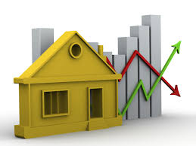
PROBLEM STATEMENT
The aim is to predict the efficient house pricing for real estate customer with respect to their budgets and priorities by analyzing previous market trends and price ranges and also upcoming developments future price will be predicted.
We do not have accurate measures of housing prices based on the vast amount of data available. Simulation results show that the FLSR provides a superior prediction function as compared to ANN(Artificial neural network) and FIS(Fidelity National Information Services) in capturing the functional relationship between dependent and independent variables and has the lowest computational complexity.
Price = ?
OR

Slide 5
WHY DATA EXPLORATION IS IMPORTANT ?
Business : Come up with an optimal business solution to the problem.
Data exploration allows us to : (Brainstorm ideas, check if data is appropriate, See the behaviour of the data)
Communicate the data to stakeholders to help explain your prediction.
Different tools can be used R, Python, Power Bl, Excel!

Slide 6
LIMITATIONS OF PREVAILING METHODOLOGIES
There is a notable amount of research done in the house price prediction department but very research has come up to any real-life solutions. There is very little evidence of a working house price predictor set up by a company. For now, very few digital solutions exist for such a huge market and most of the methods used by people and companies are as follows:
Buyers/Customers
Seller/Agencies

Slide 7
Buyers and Customers
People frequently go online to research trends and other relevant information when they first consider buying a home or other real estate.
People do this to search for a home with all the amenities they require. People take note of the cost associated with these houses as they work.
The common person, however, lacks reliable information and extensive expertise of the pricing.
Making contact with several estate agents is the second thought that comes to mind when looking for a property.
The issue with this is that these agents should only be paid a small amount for looking at houses and determining a price for you.
Most of the time, consumers mindlessly accept this price because they have no other choices. In some instances, agents and sellers may have a covert agreement, and the buyer may be unknowingly offered a home at an inflated price.

Slide 8
Seller/Agencies:
When an individual thinks of selling his/her property they compare their property with hundreds and thousands of other properties which are posted all around the world.
Determining the price by comparing it with multiple estates is highly time-consuming and has a potential risk of incorrect pricing.
Large Real estate companies have various products they need to sell and they have to assign people to handle each of these products.
This again bases the prediction of a price tag on a human hence there is room for human error.
Additionally, these assigned individuals need to be paid.
However, having a computer do this work for you by crunching the heavy numbers can save a lot of time money and provide accuracy which a human cannot achieve.

Slide 9
LITERATURE REVIEW
S.NO | TITLE | DESCRIPTION | TECH USED | PROS | CONS
1. | Real Estate price prediction | prediction can help the developer determine the selling price of a house and can help the customer to arrange the right time to purchase a house. | Data science technique | Makes optimal use of the linear regression algorithm | Tough to store huge data and Extract at once
2. | Real Estate Price Prediction using machine learning | both the consumer and the developer by assisting in the selection of the appropriate time to sell a home | ML Algorithms, R, Rapid Miner, Tableau | This research helped people to invest smartly in property

Slide 10
S.NO | TITLE | DESCRIPTION | TECH USED | PROS | CONS
3. | Real Estate Price Prediction | Real Estate Property is not only the basic need of a man but today it also represents the richness and prestige of a person. Investment in the real estate generally seems to be profitable because their property values do not decline rapidly. | Random Forest, Gradient Boosting, Linear Regression, Decision Tree | flexible solution for estimating the price of any real estate property on the go rather than the other techniques with less accurate solutions. | Tough to store huge data and Extract at once

Slide 11
PROPOSED WORK
The purpose of this system is to determine the price of a house by looking at the various features which are given as input by the user. These features are given to the ML model and based on how these features affect the label it gives out a prediction.
This will be done by first searching for an appropriate dataset that suits the needs of the developer as well as the user. Furthermore, after finalizing the dataset, the dataset will go through the process known as data cleaning where all the data which is not needed will be eliminated and the raw data will be turned into a .csv file.
Moreover, the data will go through data preprocessing.
Consequently an algorithm and model will be finalized which can yield accurate predictions.
Users and companies will be able to log in and then fill a form about various attributes about their property that they want to predict the price.
Additionally, after a thorough selection of attributes, the form will be submitted.
This data entered by the user will then go to the model and within seconds the user will be able to view the predicted price of the property.

Slide 12
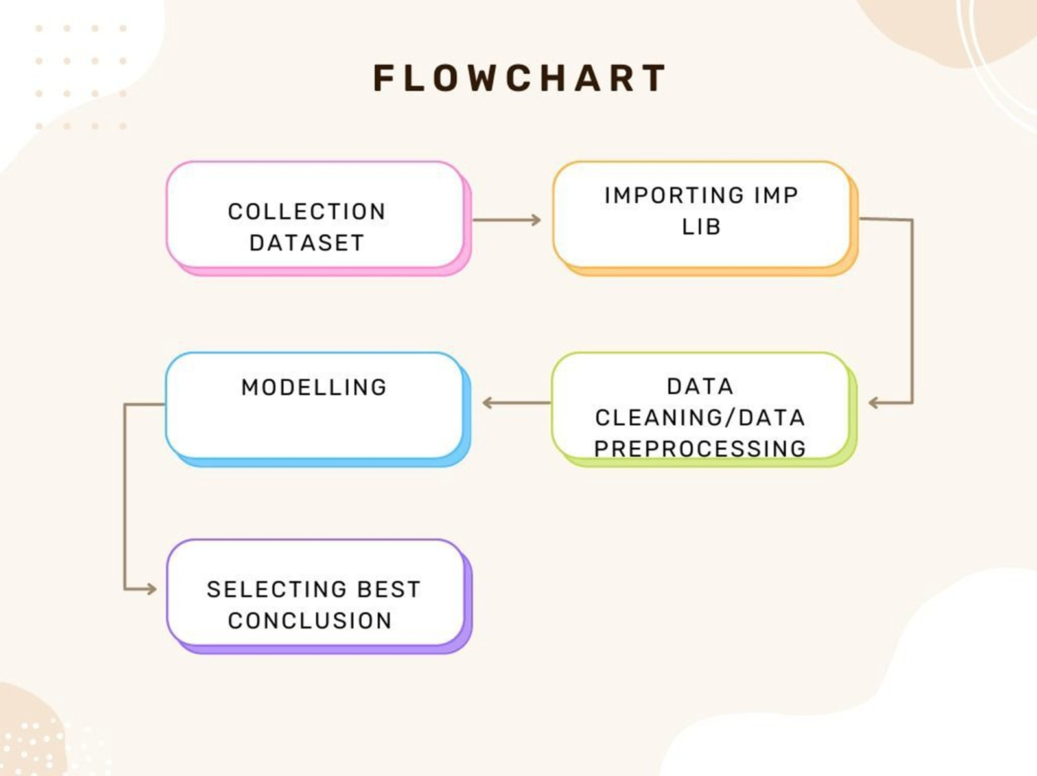
Flow Chart

Slide 13
Methodology
We will work on multiple datasets to increase the accuracy of our model
Random forest: Random forest is a Supervised Machine Learning Algorithm that is used widely in Classification and Regression problems.
Decision tree: Decision Trees (DTs) are a non-parametric supervised learning method used for classification and regression.
Xg boost: which stands for Extreme Gradient Boosting, is a scalable, distributed gradient-boosted decision tree (GBDT) machine learning library. It provides parallel tree boosting and is the leading machine learning library for regression, classification, and ranking problems.
Linear regression: Linear Regression is a machine learning algorithm based on supervised learning. It performs a regression task. Regression models a target prediction value based on independent variables. It is mostly used for finding out the relationship between variables and forecasting.

Slide 14
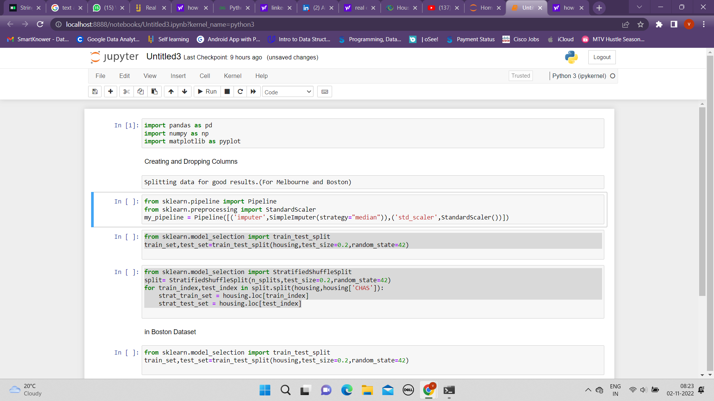
IMPLEMENTATION

Slide 15
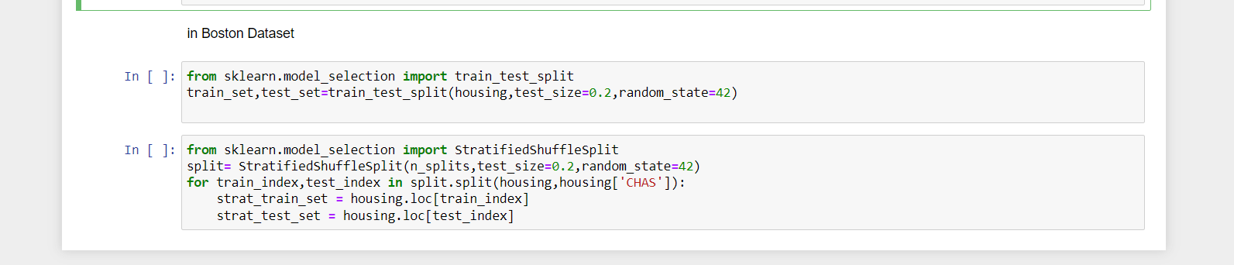

Slide 16
Conclusion
Every person hopes to one day own their own home. We want people to acquire homes and other real estate using this suggested approach, and we also want to make sure that they don't fall for shady salespeople who are only out for their clients money.
In addition, this approach will assist large businesses by providing them with precise pricing projections, sparing them much aggravation, and enabling them to save a significant amount of time and money. We aim to assure that by employing this model that real estate prices are accurate, which is the essence of the market.

Slide 17
References
[1]IJERT Volume 10, Issue 04 (April 2021).
[2]Kuvalekar, Alisha and Manchewar, Shivani and Mahadik, Sidhika and Jawale, Shila, House Price Forecasting Using Machine Learning (April 8, 2020). Proceedings of the 3rd International Conference on Advances in Science & Technology (ICAST) 2020
[3] Bindu Sivasankar, Arun P. Ashok, Gouri Madhu, Fousiya S , "House Price Prediction" , International Journal of Computer Science and Engineering(IJCSE), Vol: 8 Issue: 7, 2020.
[4]ALISHA KUVALEKAR SHIVANI MANCHEWAR SIDHIKA MAHADIK HOUSE PRICE FORECASTING USING MACHINE LEARNING April 2020. [11] Ayush Varma, Abhijit Sarma,Rohini Nair,Sagar Doshi House Price Prediction Using Machine Learning and Neural Networks 2018 Second International
[5]M Thamarai, S P Malarvizhi, " House Price Prediction Modeling Using Machine Learning", International Journal of Information Engineering and Electronic Business(DJIEEB), VoL12, No.2, pp. 15- 20, 2020. DOI: 10.5815/ijieeb.2020.02.03
[6]G. Naga Satish, Ch. V. Raghavendran, M.D.Sugnana Rao, Ch.Srinivasulu , "House Price Prediction Using Machine Learning" , International Journal of Innovative Technology and Exploring Engineering (IJITEE), Volume-8 Issue-9, 2019.

Slide 18
References
[7]Atharva Chouthai, Mohammed Athar Rangila , Sanved Amate, Prayag Adhikari, Vijay Kukre , "House Price Prediction Using Machine Learning" , International Research Journal of Engineering and Technology(IRJET), Vol:06 Issue: 03, 2019.
[8]B.Balakumar, P.Raviraj, S.Essakkiammal , "Predicting Housing Prices using Machine Learning Techniques".
[9]Akshay Babu, Dr. Anjana S Chandran , "Literature Review on Real Estate Value Prediction Using Machine Learning" , International Journal of Computer Science and Mobile Applications, Vol: 7 Issue: 3, 2019.
[10] Mr. Rushikesh Naikare, Mr. Girish Gahandule, Mr. Akash Dumbre, Mr. Kaushal Agrawal, Prof. Chaitanya Manka , "House Planning and Price Prediction System using Machine Learning" , International Engineering Research Journal, Vol:3 Issue: 3, 2019.
[11] Akshay Babu, Dr. Anjana S Chandran , "Literature Review on Real Estate Value Prediction Using Machine Learning" , International Journal of Computer Science and Mobile Applications, Vol: 7 Issue: 3, 2019.
[12] Mr. Rushikesh Naikare, Mr. Girish Gahandule, Mr. Akash Dumbre, Mr. Kaushal Agrawal, Prof. Chaitanya Manka , "House Planning and Price Prediction System using Machine Learning" , International Engineering Research Journal, Vol:3 Issue: 3, 2019.

Slide 19
THANK YOU

